Slide 1
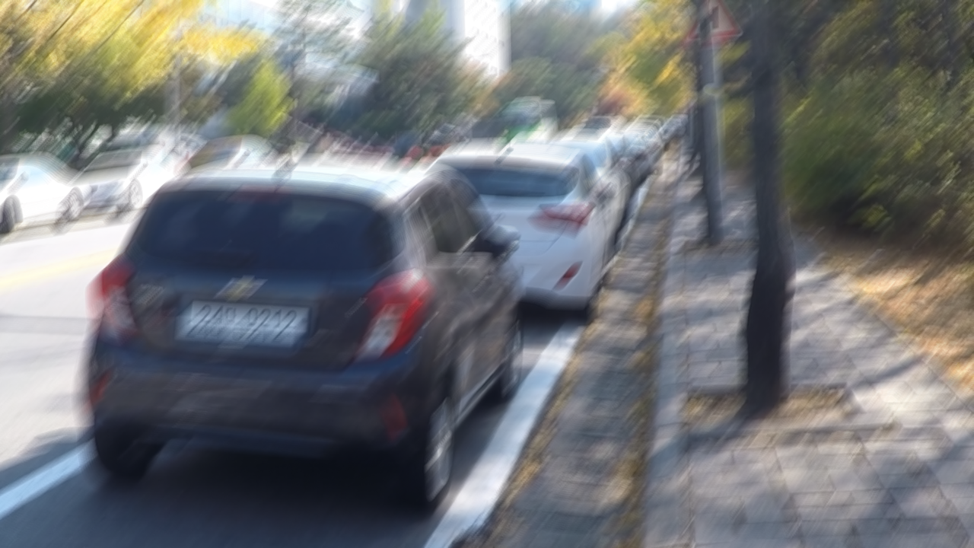

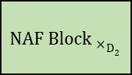
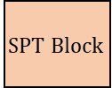
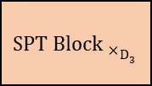
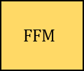
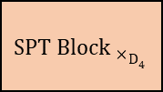

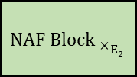
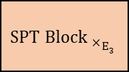

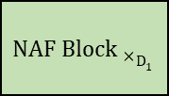
Feature Fusion Middleware
$$SPT Block$$
NAF Block
Multi-Head Attention Middle Block
Downsample
$${SPT Block }_{×}E_{4}$$
$${SPT Block }_{×}D_{4}$$
Upsample
+
Element-wise addition
Prompt
$${SPT Block }_{×}E_{3}$$
$$FFM$$
$${SPT Block }_{×}D_{3}$$
$${NAF Block }_{×}E_{2}$$
$${NAF Block }_{×}D_{2}$$
Check size
Conv
$${NAF Block }_{×}E_{1}$$
$${NAF Block }_{×}D_{1}$$
Conv

Slide 2
Prompt
1x1 conv
SGFF
·
1x1 conv
3x3 dconv
R
LN
S
1x1 conv
3x3 dconv
R
R
1x1 conv
MHPA
Input Feature
Refined Feature
3x3 dconv
LN
1x1 conv
3x3 dconv
R
1x1 conv
（a）
（b）
（c）
LN
1x1 conv
SCA
1x1 conv
LN
1x1 conv
SG
1x1 conv
GAP
Conv
3x3 dconv
SG
（a）
（b）

Slide 3
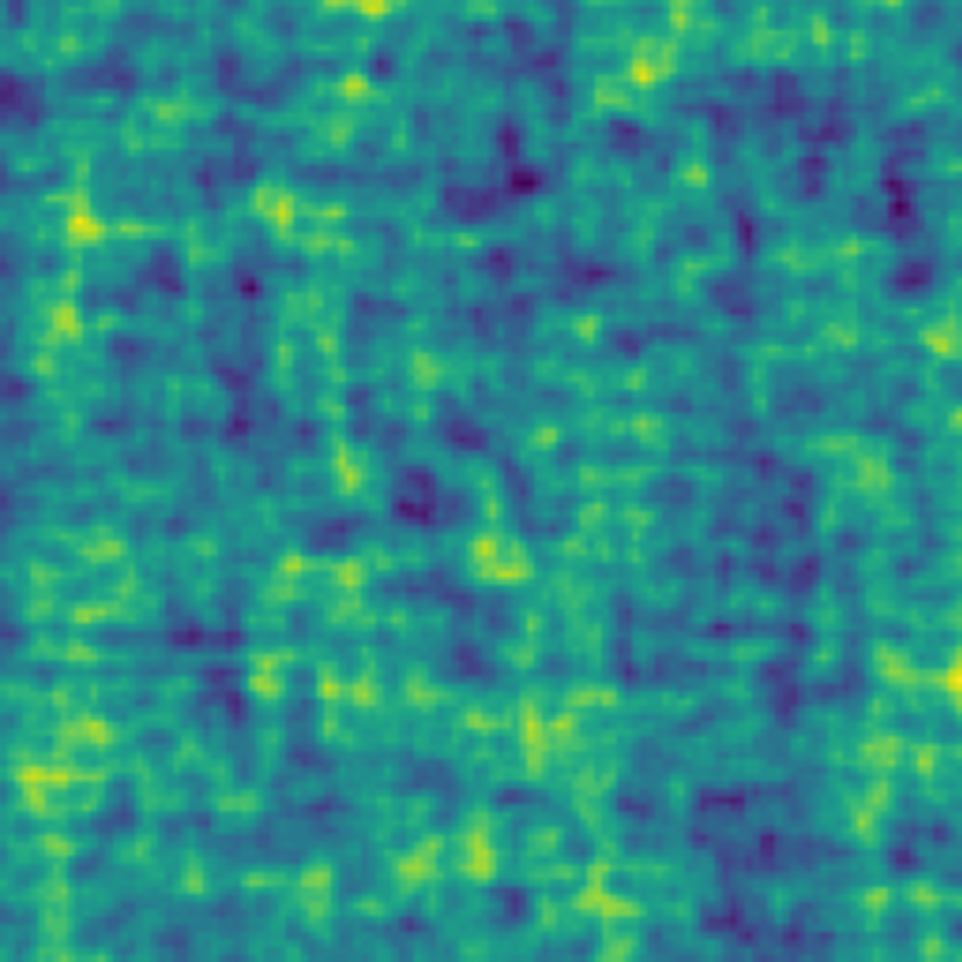
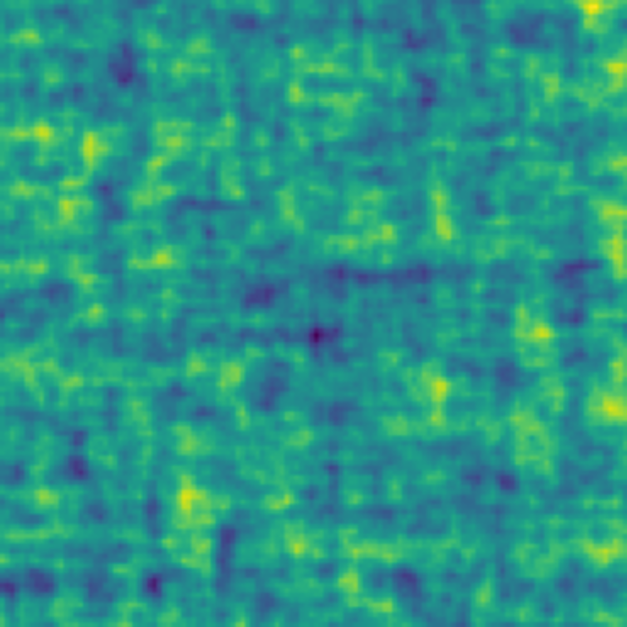
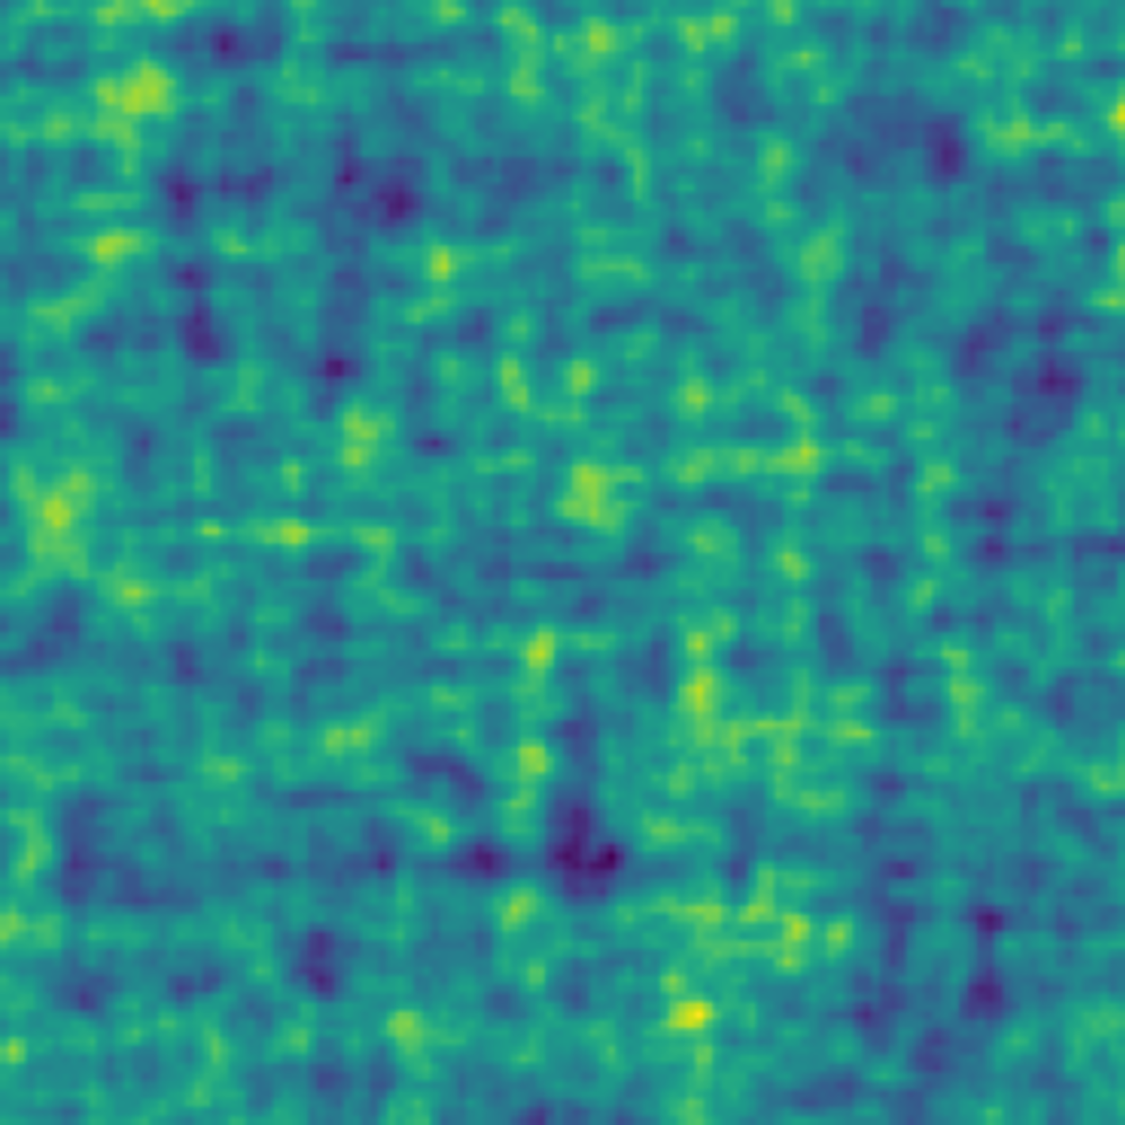
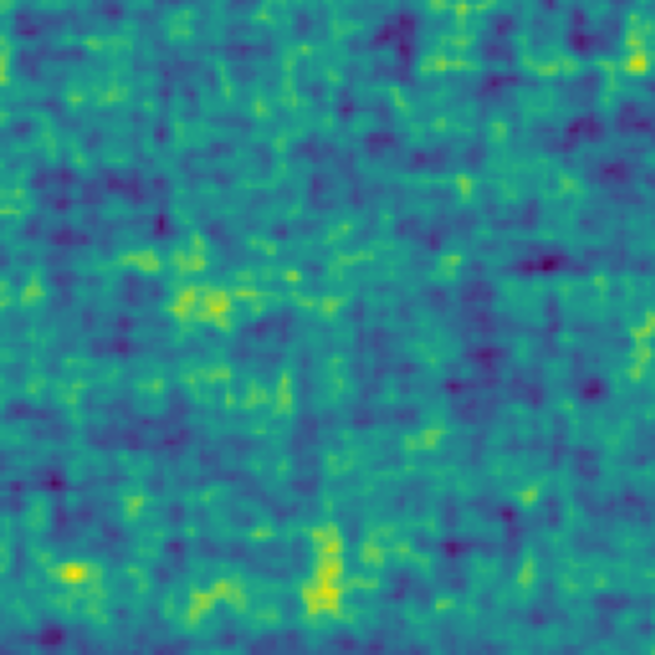
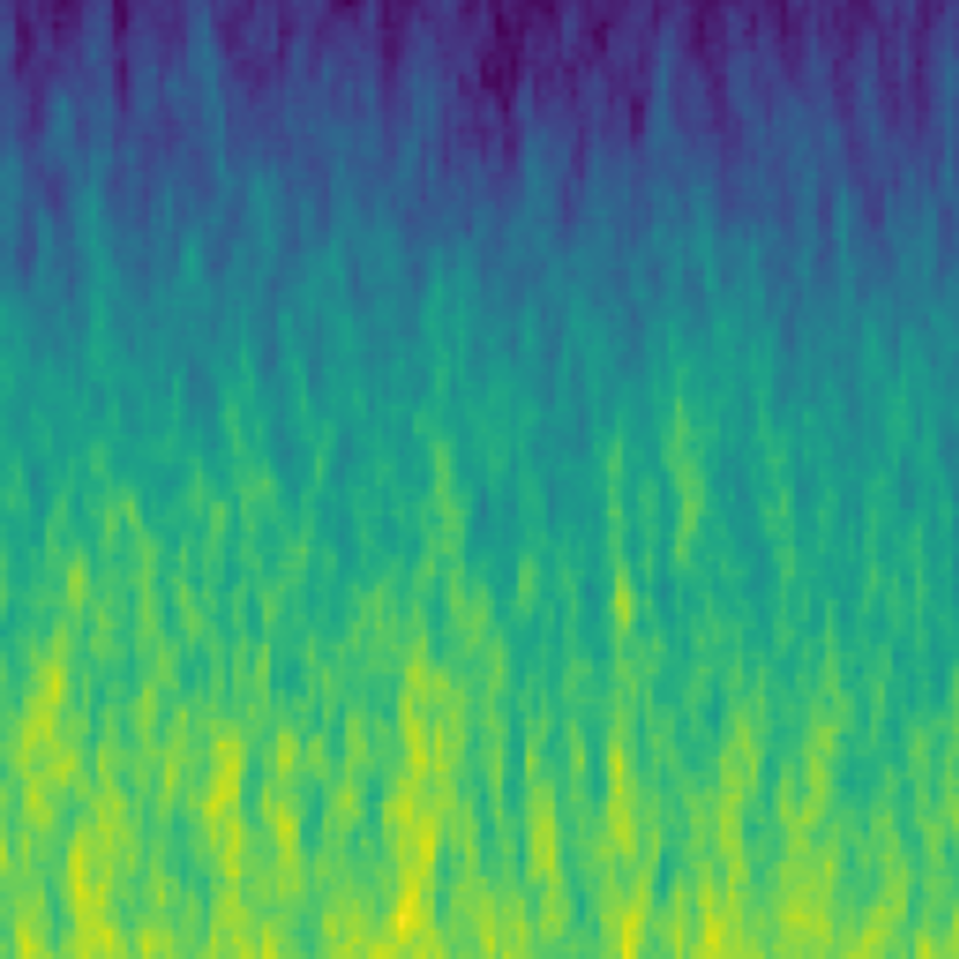
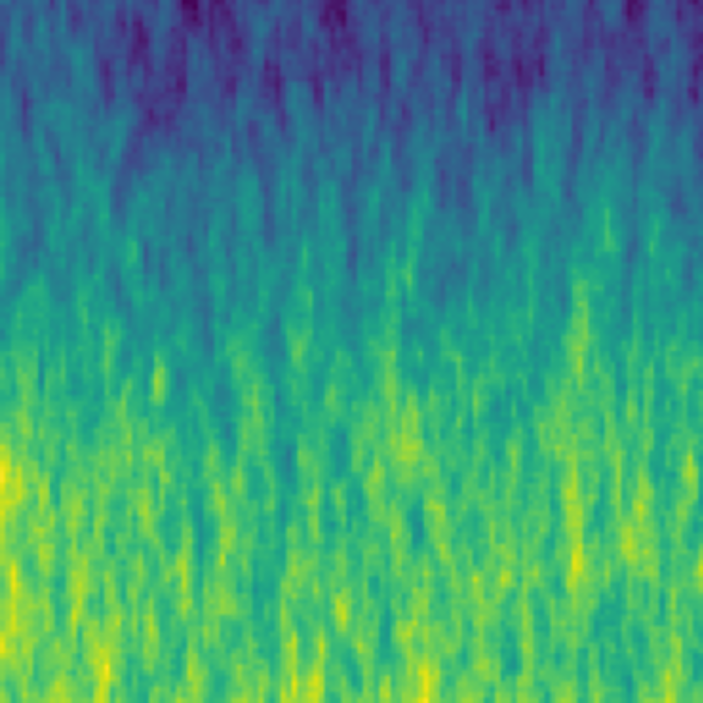
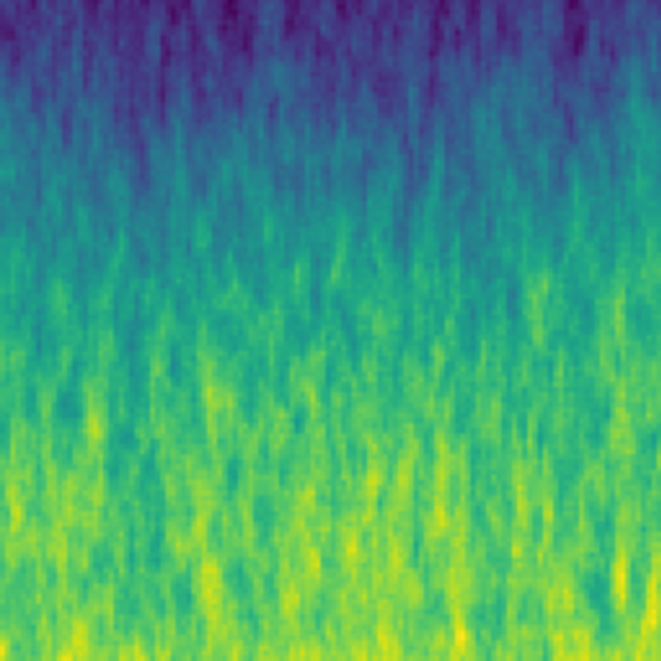
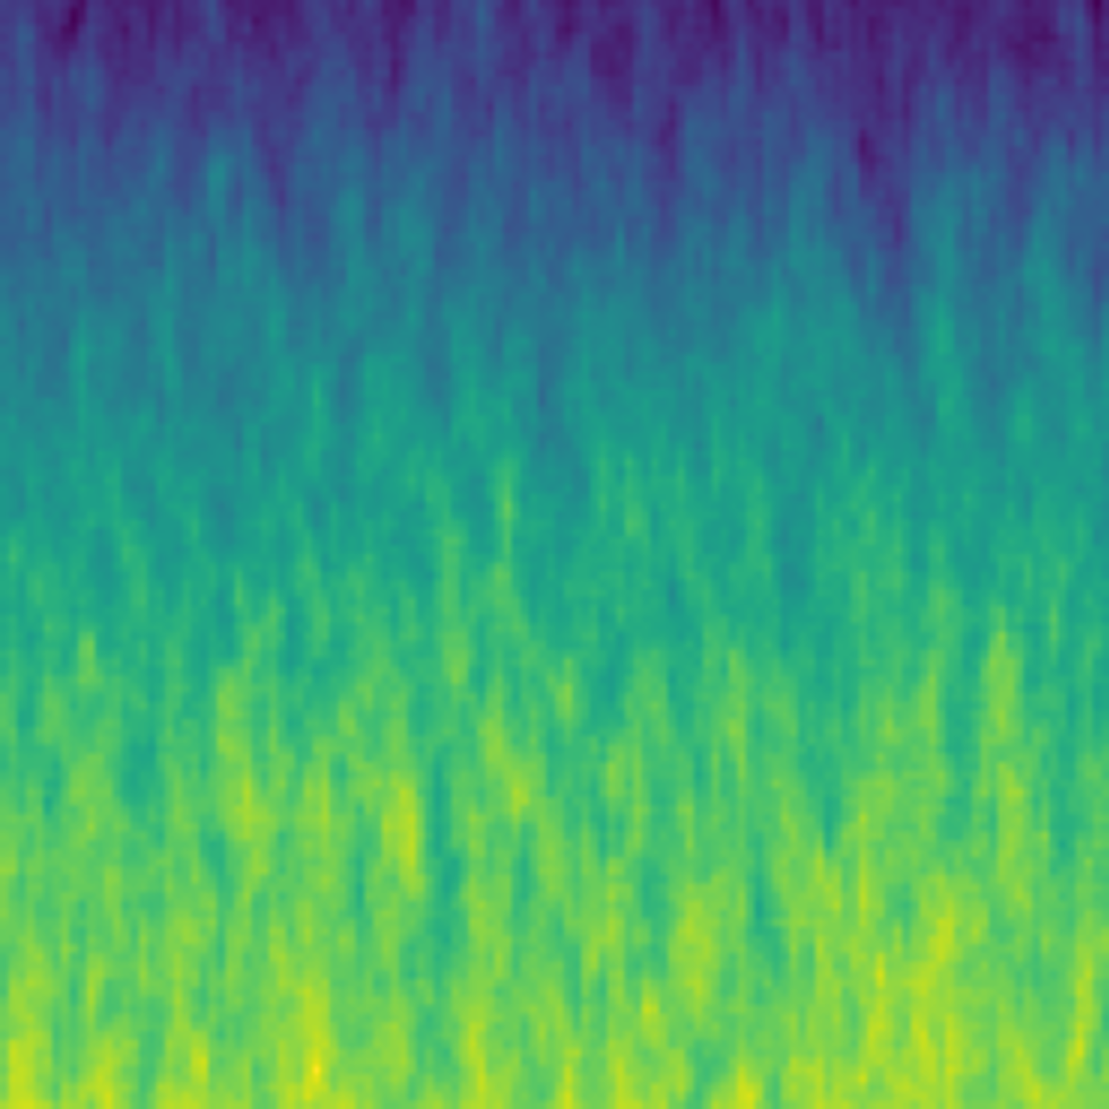

Slide 4
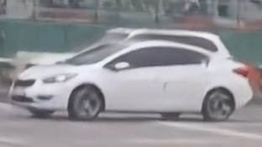
23.42 dB
Blurry Image
PSNR
Reference
23.42 dB
Blurry
29.95 dB
MPRNet-Local
30.25 dB
Restormer-Local
31.74 dB
NAFNet
32.12 dB
FFTformer
32.33 dB
CATNet (ours)

Slide 5
23.42 dB
Rainy Image
PSNR
Reference
23.42 dB
Rainy
29.95 dB
MPRNet
30.25 dB
Restormer
31.74 dB
Uformer
32.12 dB
DRSformer
32.33 dB
CATNet (ours)

Slide 6
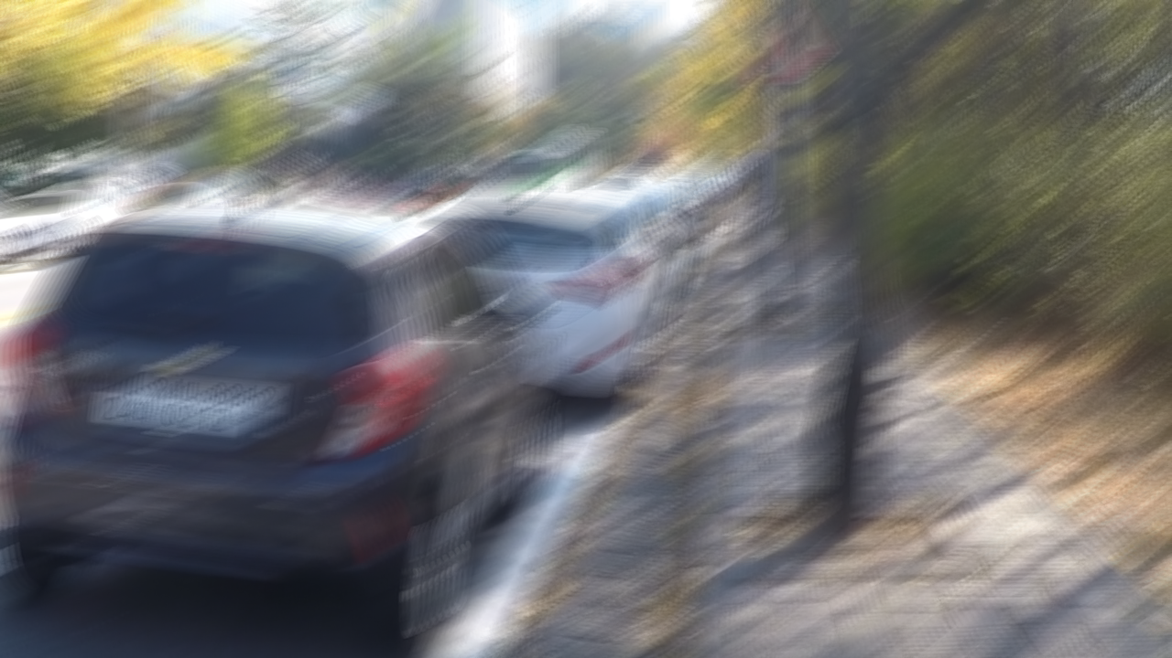
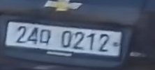
PSNR
Reference
20.37 dB
Blurry
25.44 dB
MPRNet
20.37 dB
Blurry Image
25.61 dB
NAFNet
26.85 dB
Restormer
27.07 dB
CATNet (Ours)

